Slide 1


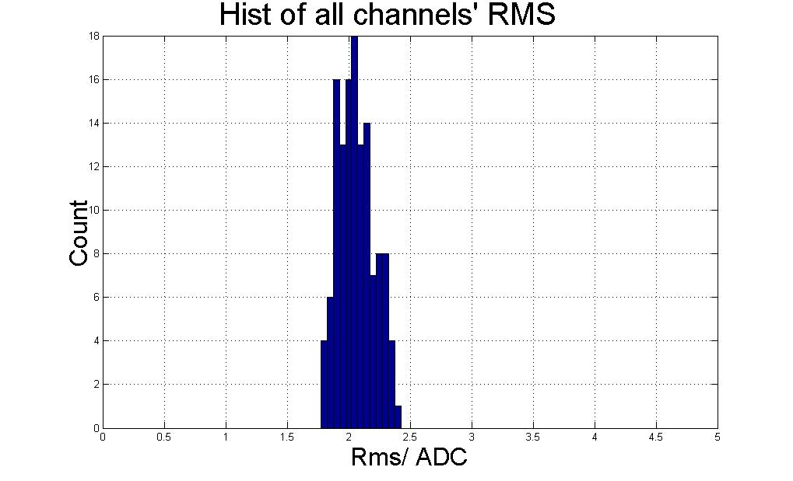
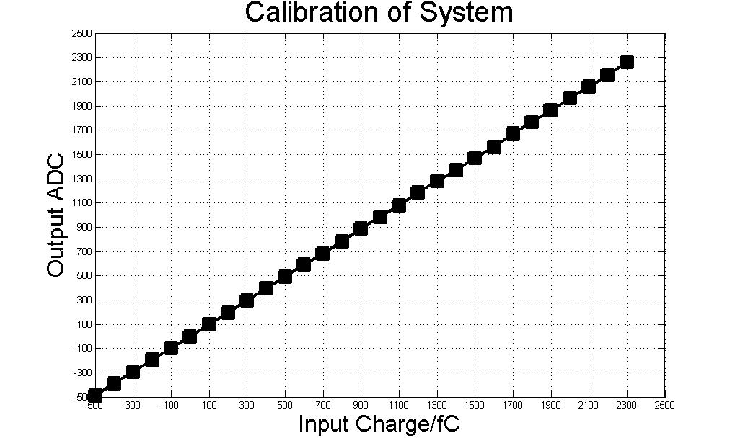
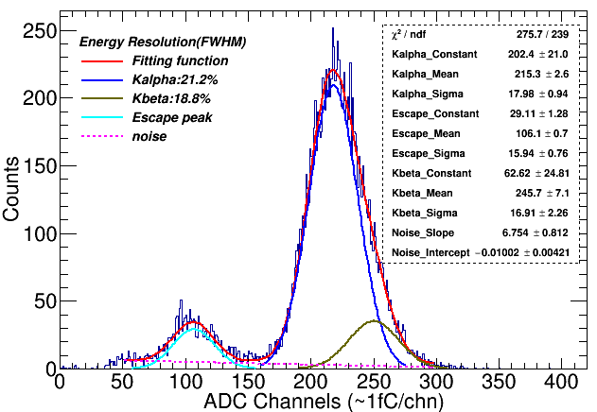
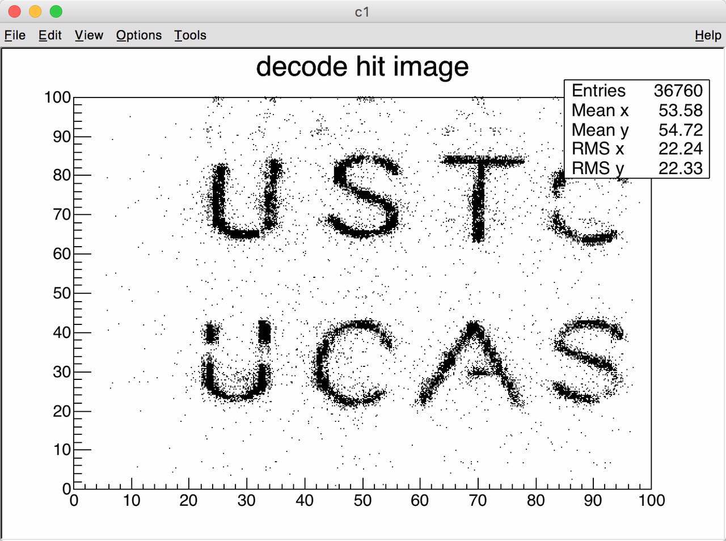
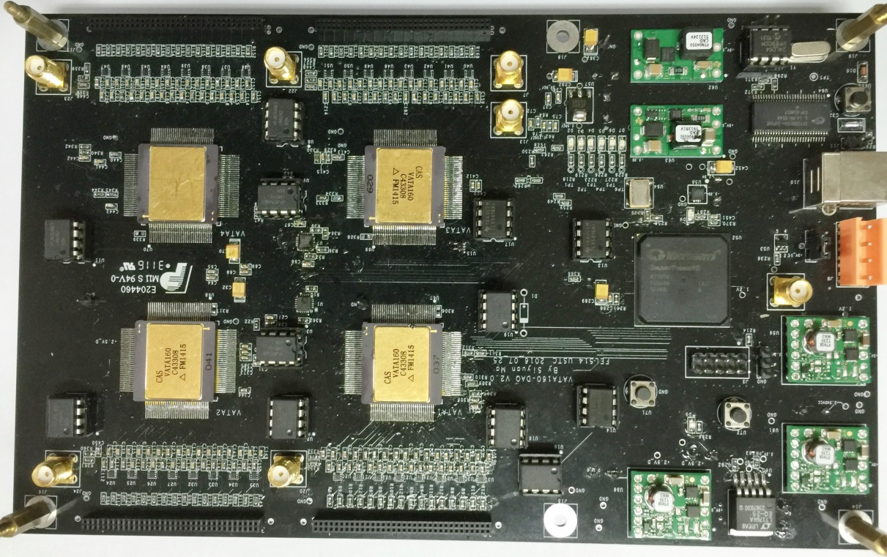
A Portable Readout System for Micro-Pattern Gas Detectors
Ma Siyuan^{1, 2} Feng Changqing^{1, 2} Luo Laifu^{1,2} Liu Shubin^{1,2} An Qi^{1,2}
¹State Key Laboratory of Particle Detection and Electronics, University of Science and Technology of China, Hefei 230026, China
²Department of Modern Physics, University of Science and Technology of China, Hefei 230026, China
Corresponding author: fengcq@ustc.edu.cn
Siyuan Ma
1.Introduction
3. Performance of readout system
With the development of high energy physics (HEP) experiments, the micro-pattern gas detectors (MPGD) are widely used in particle detection physics and space astrophysics. As a high resolution particle tracking detector, the MPGDs has a variety of applications, especially for the Micro-megas [1] and Gas Electron Multipliers (GEMs) [2].
VATA160 is a high dynamic range charge measurement readout ASIC with self-trigger function designed by IDEADS (Norway). An electronic system based on VATA160, which can acquire 128 channels of charge inputs, has been developed. This system can be used to research the performance of MPGDs. With a integration time of 1.8 us, the dynamic range is from -3pC to +13pC, and the noise is better than 2.5fC. This system is compact and portable to use. It communicates with the PC via only USB bus.
Fig.3 RMS of all channels Fig. 4 Calibration of one channel
The electronic noise was tested and the result was shown in Fig. 3. The figure indicates that the noise of every channel is better than 2.5fC. Due to the VATA160 chip having calibration circuits, the automatic calibration function was implemented on the system. A Digital-to-Analog converter (DAC, TLV5618) and an analog switch (ADG741) controlled by FPGA are used to generate voltage step pulses with different amplitudes. There is a 10pF capacitor on the board between switch and VATA160 chip, through which the pulse is turned into a certain charge with an amplitude covers the full range of the ASIC. This charge is used to simulate the detector signal. The result of calibration is shown in Fig. 4.
2. Implement of readout system:
Fig.1 Block diagram of electronic board
Fig 6. The spectrum of ⁵⁵Fe Fig 7. The results of decoded image
The block diagram of electronic board is given in Fig. 1. It mainly consists of 4 VATA160 chips, 4 Analog to Digital Converter (ADC), a Field-Programmable Gate Array (FPGA), 2 Digital to Analog Converter (DAC) and a USB interface chip. Each VATA chip has a connector of 2*32, 50 mil double row pins, which is very common in detectors, as interface to detectors.
This system was coupled with a Micro-megas detector to test the energy spectrum of ⁵⁵Fe. The result is shown in Fig. 6. The all-around peak and escape peak are clearly visible, which means the readout system is capable of performing the readout of Micro-megas detector.
In another experiment, the readout system was connected to a THGEM detector with the Two-Dimensional direct coding readout of 100*100 anode bars to perform imaging test. There was a copper plate with letter slits between the detector and X-ray generator. As is shown in Fig. 7, by decoding the hit position of the incident signal, the letter gap is clearly visible when the threshold is chosen to triple the noise.
Fig 2. Implement of the readout system
4.Conclusion
This portable readout system has been implemented as shown in Fig. 2. This system is convenient to use. It acquires the detector’s signal either from an external trigger or an internal trigger generated by VATA160. The data is transferred to PC host through a USB cable, which is also responsible for power supply of hardware and transmission of control commands from PC. Besides, a shielding box is designed and made for this system to shield external noise.
A portable readout electronics system for MPGDs are presented in this paper. The readout systems has features of low noise (less than 2.5fC), high dynamic range (-3 ~ +13pC), low power dissipation (less than 2.5W) and high integration (128 channels). This system is portable to use with only one USB bus for its supply, commands and data transmission. This system can operate with different types of MPGDs.
Technology and Instrumentation in Particle Physics 2017 Author e-mail: siyuanma@mail.ustc.edu.cn
Fig 13. Joint test platform

